Slide 1
Chapter 10
Cyber-physical systems, IoT, medical systems, social networks

Slide 2
Embedded systems
An embedded system is a computational system which is part of a larger system
Used in car, aircraft, boat control systems, smart appliances, …
Can be fixed or wireless; some are partially wireless
Often use special protocols
Specialized distribution architectures: Jini, Microsoft’s Universal Plug and Play (UPnP), Sony’s Havi, ...

Slide 3
JINI (Apache River)
Jini network technology is an open distributed architecture that enables developers to create network-centric services (plug and play devices), intended for flexibility
In Jini, everything is a service, a system is a federation of services. Once part of a federation, a service can be used by any clients in the network (a type of SOA)
Services are discovered and leased
The network functions take over some of the OS functions. Includes a programming model and a runtime infrastructure
Jini runs on top of local operating systems. Services are organized into groups. Security based on ACLs
Complemented with sensors

Slide 4
Modeling physical systems: Sensor node structure
Transceiver
Sensor
Power Source
Processor
ADC
Memory
Sensor

Slide 5
Sensor node pattern

Slide 6
A sensor network

Slide 7
Sensor network architecture

Slide 8
Advantages
If some nodes cannot reach the sink directly, other nodes can help them by relaying their data.
Clusters allow the management or securing of sec­tions of the network by deﬁning a cluster head that can control different functions.
Specialized, resource-rich nodes (called supernodes in this paper) can be inserted in the network. For example they can have more processing power to do ﬁltering, to keep logs, or to store authentication information, or they can have a larger communication range. Using supernodes, the WSN could achieve better performance such as longer network lifetime, better latency, and reliability [Sta05].
The model is also suitable for simulations.
Depending on the application requirements, a WSN can have more or less number of sensor nodes and it can be homogeneous or heterogeneous. Architectures using clusters or supernodes are scalable with the number of sensor nodes. The number of supernodes deployed will depend on the network size.
Depending on the application requirements, the WSN can be extended with security mechanisms.
Organizing the sensors in a WSN provides a cost efficient solution, since the same sensor nodes are used both in data sensing and data relaying.

Slide 9
Cyber-Physical Systems (CPSs)
A cyberphysical system (CPS) integrates computing and communication capabilities with the monitoring and control of entities in the physical world
Normally distributed, real-time, usually include embedded devices, sensors, and wireless links
Many system components are remotely deployed, have unique constraints, and may be physically inaccessible for maintenance, and/or physically accessible for attack
Examples include transportation systems, smart power grids, patient monitoring, smart buildings, flexible manufacturing systems, and many others
CPSs exhibit at least two clear architectural levels: a hybrid control loop (lower level) and an information loop, which usually includes databases. Frequently there re more levels.
CPSs require a high level of adaptability because of continuously-changing conditions and need situation awareness and modifiability
They may include legacy systems and they increasingly include humans in the loop.
Typically, they use combinations of Commercial Off The Self (COTS) components and real-time operating systems, as well as products from different vendors and using different protocols
Many CPS also need to follow government or state regulations

Slide 10
Other Characteristics of CPS
Cyber – physical coupling driven by new demands and applications
Cyber capability in every physical component.
Large scale wired and wireless networking.
Networked at multiple and extreme scales.
Systems of systems
New spatial-temporal constraints.
Complex at multiple temporal and spatial scales.
Dynamically reorganizing/reconfiguring.
Unconventional computational and physical substrates (Bio? Nano?).
Novel interactions between communications, computing and control
High degrees of automation, control loops must close at all scales.
Large numbers of non-technical savvy users in the control loop.
Ubiquity drives unprecedented security and privacy needs
Operation must be dependable, certified in some cases

Slide 11
Cyber-physical systems (CPSs) III
Often, CPSs are safety-critical, because their failure could endanger lives or cause large economic losses. Safety is the freedom from unacceptable risks, including threats to human lives, the environment, or to costly facilities.
Wireless networks and inexpensive sensors have made them much more important
UML can be used to represent software but also physical things
As we saw in the sensor models things can be represented by classes which indicate physical features and include commands to interact with the thing

Slide 12
Infrastructure systems
Infrastructure systems are needed to sustain a civilized life
They include transportation, finance and banking, government, chemical, energy, oil and gas production and distribution, health services, information management, water (drinking and irrigation), emergency services (fire, police), garbage collection, and other areas
All of these infrastructure functions are controlled by CPSs which are complex and becoming increasingly interdependent; each system typically depends on one or two other systems
Some are even mutually dependent, e.g. electric power generation may require oil, and oil production may require electricity.
Most of them are organized as control systems (SCADA: Supervisory and Data Acquisition )

Slide 13
Examples of cyberattacks to infrastructure
In the spring of 2000 a disgruntled Australian employee used a radio transmitter to disrupt the controls of a sewage treatment system. He caused some pumping stations to malfunction which resulted in large amounts of raw sewage to be released into several local rivers
In October of 2002, a coordinated DDoS attack flooded all root servers of the Internet with a high volume of traffic. The servers incurred significant delays but were able to keep up with the traffic
Spyware was discovered in computers in the office of the German chancellor, Angela Merkel, and in some other government offices. The suspects were China’s People Liberation Army (PLA).
Russian hackers attacked the websites of the government and financial institutions in Estonia. This was a response to Estonia’s removal of a Soviet war monument in Tallinn (the capital). The attacks involved denial of service and web site defacing and disrupted these sites for several weeks.
In September 2004, air traffic controllers lost voice contact with 400 airplanes over the SW US, when the main voice communication system shutdown unexpectedly. The backup system that took over also crashed almost immediately after taking over. Air controllers resorted to cell phones and most planes had collision avoidance systems, and there were no collisions.

Slide 14
Supervisory Control and Data Acquisition (SCADA) systems structure

Slide 15
SCADA units
A control loop. This includes sensors, controllers, actuators, and communication links, that operate on a controlled process. Sensors collect information from the controlled process and send it to the controller which adjusts parameters based on these values and their set points.
A human-machine interface (HMI). Used by engineers and operators to define set points, control algorithms, and adjust parameters. The HMI also displays status information and historical information.
Remote diagnostic and maintenance functions. Used to identify and recover from failures or attacks.
Databases. Contain control information, settings, historical information (logs), …
Communication networks. To connect all the units.
SCADAs are the most important type of CPS.

Slide 16
General SCADA architecture

Slide 17
SCADA security in practice
The basic architecture of SCADA systems is multi-tier, with physical measurement and control endpoints that serve as sensors and actuators. The processors for these sensors and actuators generally run on ordinary commercial operating systems such as VMS, Unix, Windows and Linux and the human interfaces often run on MS-Windows systems.
In practice, SCADA systems lack authentication, are not patched at all (because there never seemed to be any need for patches), and are generally viewed as unconnected to the Internet
SCADA systems are typically subject to multiple undocumented, uncontrolled interconnections
The problem is worsened by inadvertent interconnections when security-unaware users connect mobile devices such as notebook computers to SCADA systems while they are simultaneously connected to other networks – including direct connections to the Internet – through wireless connections.

Slide 18
SCADA Pattern
Central Controller
Communication Network
Field Unit
1
1
1
1
*
*
*
1
Human-Machine Interface
Data Server
Field Unit
Local Controller

Slide 19
Methodology for SCADA Systems
We can analyze, build and evaluate secure SCADA systems using security patterns
We use security patterns to stop and/or prevent the attacks and we list these attacks first
The result is a security pattern itself which is called the Secure SCADA Pattern and which can be used as a guideline for building secure SCADA systems
We only indicate the patterns used to counteract the threats, we have published detailed descriptions of all of them

Slide 20
SCADA threats
Threats against/through the central controller include those such as (i) physical attacks, (ii) malicious settings of the field units, (iii) wrong commands to the field units, (iv) malicious alteration of the runtime parameters of the central controller, and (v) denial of service attacks.
Threats against/through the field units include those such as (i) physical attacks, (ii) malicious alteration of the runtime parameters of the field units, (iii) wrong commands to the field units, (iv) malicious alarms to the central controller, and (v) denial of service.
Threats against/through the communication networks include (i) sniffing, (ii) spoofing, and (iii) denial of service.
Attacks against the central controller and the network are more harmful since they may disable the whole system, whereas attacks against ﬁeld units only affect speciﬁc units

Slide 21
Countermeasures
Central controller. To stop T1, we use security patterns for physical access control such as the Role-Based Access Control (RBAC) pattern combined with the Authenticator Pattern and the Logger Pattern
To stop T2, T3, and T4, we use the Authorization Pattern together with the Authenticator Pattern and the Secure Logger Pattern. The Authenticator restricts access to the system to only registered employees, the Authorization pattern controls the actions that the employees can do on the controller, and the logger is useful for those cases where a legitimate employee is trying to perform sabotage (we cannot stop the attack but we have a record of who did it)
To stop T5, we use the Firewall Pattern together with an Intrusion Detection System (IDS) pattern. The IDS detects the attack and instructs the firewall to block traffic from the attacking addresses

Slide 22
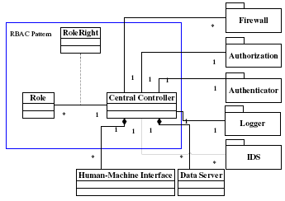
Defenses for the Central Controller

Slide 23
Rest of the system
Similarly we can analyze the network and the field units
For them we find the threats and we apply security patterns to control them
This results in a Secure SCADA pattern

Slide 24
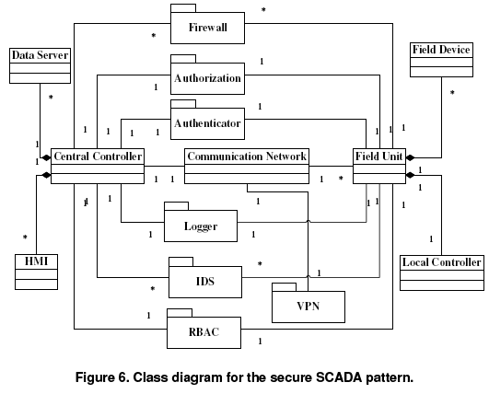

Slide 25
A typical SCADA system in use
Includes a Process Control Network and a Control System Network.
The Process Control Network consists of WinCC and PCS7 clients and servers which are connected to PLCs and enable communication with them.
WinCC machines provide HMI client/server systems used to monitor the industrial process and visualize basic data collection functions for project data, process values, archives, alarms and messages. PCS7 servers pro-vide all process data and connect PLCs to the Process Control Network.
The control system network includes WinCC/PCS7 servers and PLCs. It controls and supervises the physical process.
PCS7/WinCC server and client can be installed on the same hardware.
PLCs send control signals via a Process Field Bus (Proﬁbus) to speed regulators that control the rotation of motors. This network includes as well WinCC SQL Server databases and other engineering or maintenance workstations.
We suppose that, for security reasons, the SCADA system is isolated by an air gap so that no network connection is possible between the two security zones.

Slide 26
The Business Corporate Network
It hosts the Enterprise usual Information System. It comprises servers and workstations that enable classical daily applications (emails, reporting, accountability...), the Enterprise Resource Planning (ERP) system, etc.
It may also host WinCC SQL Server databases that provide high level information to end users and store STEP7 project ﬁles, as well as applications that manage PCS7 or WinCC projects.
Data can be exchanged between terminals via a local area network that hosts local databases and process information servers. This network can exchange data with external networks connected to the Internet through a “demilitarized zone".
Communications are protected by ﬁrewalls and other security modules.

Slide 27
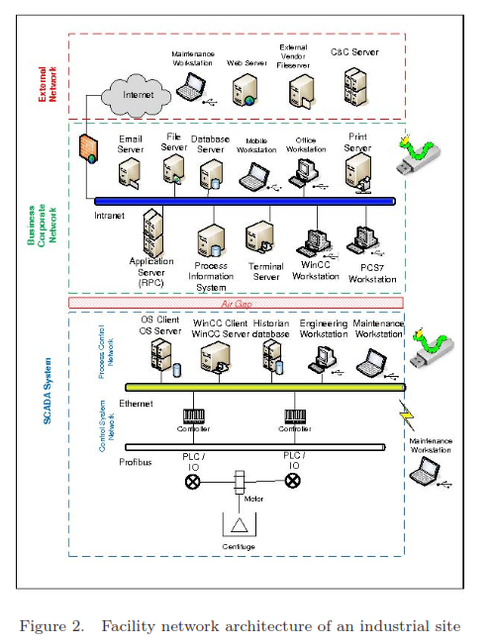

Slide 28
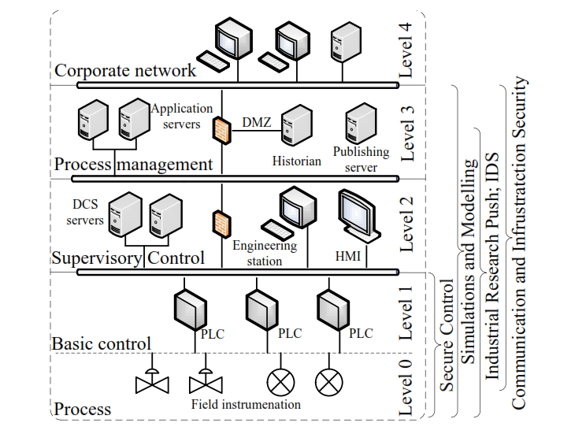
CPS architecture

Slide 29
The smart grid
The smart grid converts our current electric grid into a large and complex and heterogeneous distributed computing system
This is a cyber-physical system, which is also a virtual organization or a set of these
Parts of the system are wireless and operators will be able to check the status of devices and send them commands from their cell phones
This means a great opportunity for security attackers

Slide 30
Smart grid

Slide 31
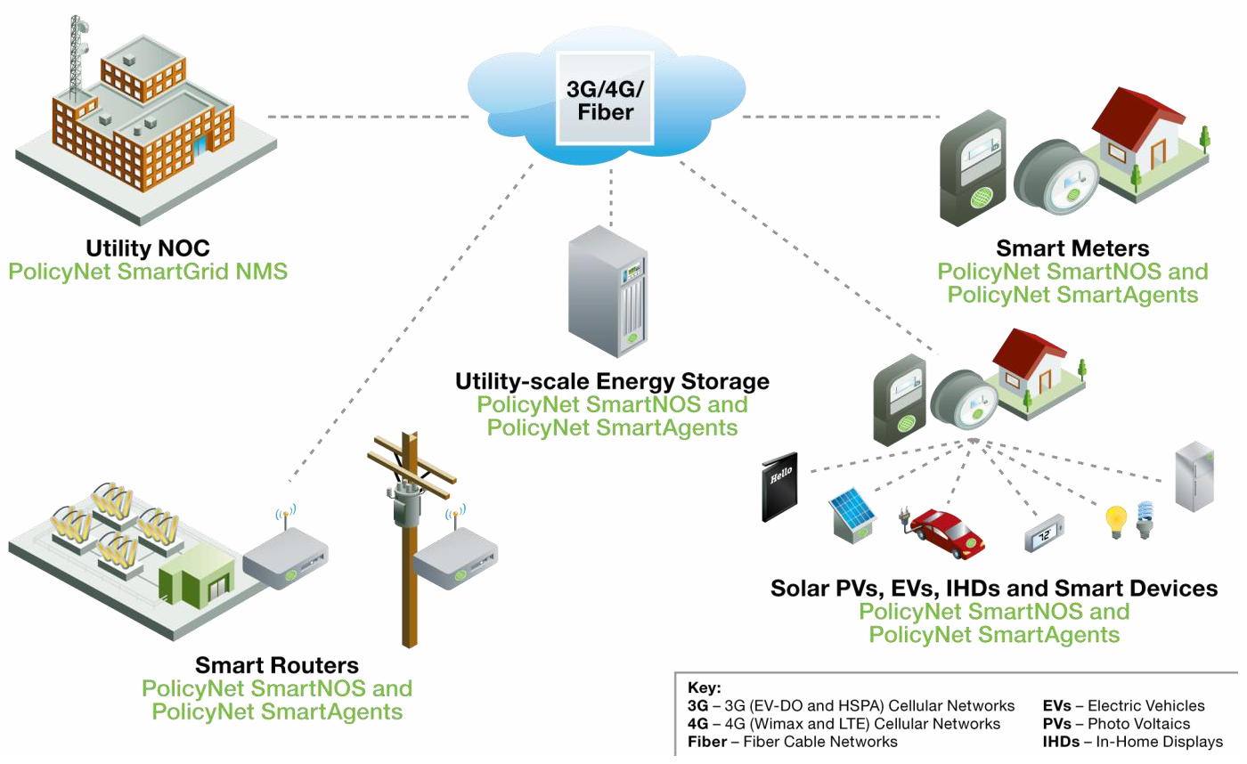

Slide 32
Privacy concerns in smart grids
Smart meters contains a processor, persistent storage, and communications (typically wireless)
If the customer generates some electricity he can sell it to the grid
Customers expose their way of using energy, the amount of energy they use, the timing of their use, their generation capacity
The grid can control appliances and send alarm messages
No privacy laws for grids exist now

Slide 33
Typical Misuses in a smart grid
Somebody in the company can snoop on customers (insider attacks)
A hacker can get customer information
Customers may commit fraud
Denial of service attacks

Slide 34
Power system attacks
Attacks to the power system itself. The customer base is affected. Other critical infrastructure systems may also be affected.
Attacks by/through the power system. Attacks to people are possible, e.g. higher voltages than expected, dispersal of biological agents through the plant facilities. Electromagnetics pulses could be sent through the electrical cables to damage computers or communication devices.

Slide 35
Standards and regulations
IEEE and NIST are creating the “Smart grid interoperability standards roadmap” [GN]
There are many regulations being discussed in the US government and in state senates
All US utilities are private companies and it is not clear how enforceable these regulations might be

Slide 36
Applying security to grids (and other CPSs)
Reference architectures (Microsoft has one [MS])
Threat modeling [Fe08]
Define policies to stop them
Build mechanisms to realize policies
Security patterns specify threat-defense mechanism correspondence [Fe11]
Secure life cycle methodology

Slide 37
A SCADA worm
Researchers have uncovered new clues that the Stuxnet worm may have been created to sabotage Iranian attempts to turn uranium into atomic bomb-grade fuel.
According to Eric Chien, one of three Symantec researchers who have dug into Stuxnet, the worm targets industrial systems that control very high speed electrical motors, such as those used to spin gas centrifuges, one of the ways uranium can be enriched into fissionable material.
Stuxnet, considered by many security researchers to be the most sophisticated malware ever, targeted Windows PCs that managed large-scale industrial-control systems in manufacturing and utility companies. .
Since the worm was first detected in June, researchers have come to believe that it was crafted by a state-sponsored team of programmers, and designed to cripple Iran's nuclear program.
Stuxnet monkeys with the output frequency over a period of months, Symantec said in its revised paper . When it finds converter drives operating between 807 Hz and 1210 Hz, the worm resets the frequency to 1410 Hz, then after 27 days, drops the frequency to just 2 Hz and later bumps it up to 1064 Hz. It then repeats the process.

Slide 38
Stuxnet
It is a highly sophisticated worm. Discovered in June 2010, Stuxnet initially spreads via Microsoft Windows, and targets Siemens industrial software and equipment. While it is not the first time that hackers have targeted industrial systems,^{[1]} it is the first discovered malware that spies on and subverts industrial systems,^{[2]} and the first to include a programmable logic controller (PLC) rootkit.^{[3][4]}

Slide 39
Children of Stuxnet
Duqu--On 1 September 2011, a new worm was found, thought to be related to Stuxnet. The Laboratory of Cryptography and System Security (CrySyS) of the Budapest University of Technology and Economics analyzed the malware, naming the threat Duqu.^{[120][121]} Symantec, based on this report, continued the analysis of the threat, calling it "nearly identical to Stuxnet, but with a completely different purpose", and published a detailed technical paper.^{[122]} The main component used in Duqu is designed to capture info such as keystrokes and system informationn
In May 2012, the new malware "Flame" was found, thought to be related to Stuxnet.^{[124]} Researchers named the program "Flame" after the name of one of its modules.^{[124]} After analysing the code of Flame, Kaspersky said that there is a strong relationship between Flame and Stuxnet. An early version of Stuxnet contained code to propagate infections via USB drives that is nearly identical to a Flame module that exploits the same vulnerability.^{[125]}

Slide 40
Children of Stuxnet
Duqu--On 1 September 2011, a new worm was found, thought to be related to Stuxnet. The Laboratory of Cryptography and System Security (CrySyS) of the Budapest University of Technology and Economics analyzed the malware, naming the threat Duqu.^{[120][121]} Symantec, based on this report, continued the analysis of the threat, calling it "nearly identical to Stuxnet, but with a completely different purpose", and published a detailed technical paper.^{[122]} The main component used in Duqu is designed to capture info such as keystrokes and system informationn
In May 2012, the new malware "Flame" was found, thought to be related to Stuxnet.^{[124]} Researchers named the program "Flame" after the name of one of its modules.^{[124]} After analysing the code of Flame, Kaspersky said that there is a strong relationship between Flame and Stuxnet. An early version of Stuxnet contained code to propagate infections via USB drives that is nearly identical to a Flame module that exploits the same vulnerability.^{[125]}

Slide 41
Physical access control
The need to protect assets in buildings and to control access to restricted areas such as airports, naval ports, government agencies, and nuclear plants, created a great business opportunity for the physical access control industry and a good amount of interest in the research community
One of the results of this interest was the recognition that access control to information and access control to physical locations have many common aspects
The most basic model of access control uses a tuple (s,o,t), subject, object, access type. If we interpret s as a person (instead of an acting executing entity), o as a physical structure (instead of a computational resource), and t as a physical access type (instead of resource access), we can make an analogy where we can apply known results or approaches from information access control
The unification of information and physical access control is just beginning but the strong requirements for infrastructure protection will make this convergence to happen rapidly
Another issue is the fact that there are standard network protocols for building automation, e.g. BACnet [bac06], which are totally different of the protocols used for manufacturing automation, e.g. DNP3. Both types of protocols define security standards, which means that a building intended for manufacturing would have two sets of incompatible security standards. We need some way to abstract the security requirements of the complete system without regard to specific standard details.

Slide 42
Patterns for physical access control

Slide 43
Patterns for physical access control
Alarm Monitoring. Defines a way to raise events in the system that might require special attention, like the tampering of a door.
Relays. Defines the interactions with electronically controlled switches.
Access Control to Physical Structures. Applies authentication and authorization (RBAC) to the control of access to physical units including alarm monitoring, relays, and time schedules that can control when things will happen.
Physical Structure [Des06]. Defines the structure and use of physical sites such as buildings, parking lots, and similar, as well as their divisions and compartments.
Scheduler. Provides timing information to control access.
Role-Based Access Control [Fer01]. Describes the standard RBAC model used here to describe authorization to access a physical unit.
Reference Monitor [Sch06]. Enforces authorizations when a process requests access to an object.
Authenticator [Fer03]. Verifies that a subject is who it says it is.

Slide 44
Alarm monitoring

Slide 45
Activating an alarm

Slide 46
Relay pattern

Slide 48
Class diagram for access control to physical structures
The Alarms Monitoring pattern can be integrated so that Zones can control Alarms
Each door has its own Door Relay and the Aux Relays can be used to turn on/off devices. Zones can control Relays.
A TimeSchedule class consists of a few time intervals. A Time Interval consists of a start time, a stop time, and selected day of the week. When the system clock activates a Time Schedule, it can automatically perform some actions. Relays can be turned on and off, alarm zones can be activated or deactivated, and doors can be unlocked
To control access times, roles are combined with Time Schedule to determine both where and when a user can gain access to zones and we also need to be able to assign a Time Schedule for the entire zone that applies to all users.

Slide 49
UC Entering a zone

Slide 50
Consequences
Advantages include:
If all users get proper authorization and such authorizations are enforced at the entrance of restricted units, we can have a secure environment.
We can add special devices to open all room doors in case of emergencies (shelves and compartments would remain closed).
We can easily accommodate visitors and contractors through special roles.
Since access to restricted units is logged, we may audit later the use of the zones and the movement of employees and visitors.
We can generate alarms.
We can turn on/off external devices using relays.
We can configure tasks to happen at a given time of a day in the week.
We can control access to Zones based on time.
We can activate/deactivate roles based on time.
A disadvantage is:
The pattern may be too complex for simple buildings.

Slide 51
The weak spot under the hood http://www.nytimes.com/2015/09/27/business/complex-car-software-becomes-the-weak-spot-under-the-hood.html
New high-end cars are among the most sophisticated machines on the planet, containing 100 million or more lines of code.
The sophistication of new cars brings numerous benefits — forward-collision warning systems and automatic emergency braking that keep drivers safer are just two examples. But with new technology comes new risks.
The unfolding scandal at Volkswagen — in which 11 million vehicles were outfitted with software that gave false emissions results — showed how a carmaker could take advantage of complex systems to flout regulations.
it is possible to disable a car’s brakes with an infected MP3 file inserted into a car’s CD player. A hacking demonstration by security researchers exposed how vulnerable new Jeep Cherokees can be.

Slide 52
Car security
Andy Greenberg steered a 2014 white Jeep Cherokee down a highway in St. Louis, cruising along at 70 miles per hour. Miles away, two local hackers sat on a leather couch at Mr. Miller’s house, laptops open, ready to wreak havoc.
As Mr. Greenberg sped along, both hands on the wheel, his ride began to go awry. First, the air-conditioning began blasting. Then an image of the hackers in tracksuits appeared on the digital display screen. Rap music began blaring at full volume, and Mr. Greenberg could not adjust the sound. The windshield wipers started and cleaning fluid sprayed, obstructing his view. Finally, the engine quit.
The episode was in fact a stunt orchestrated by the hackers and Mr. Greenberg, a writer for Wired magazine, to demonstrate the Jeep’s very real vulnerabilities. The article appeared on July 21.
Days later, Fiat Chrysler, the maker of Jeep,announced a recall of 1.4 million vehicles to fix the flaws the hackers had identified — the first known recall intended to address a possible hacking threat.

Slide 53
Drone hijacked by hackers from Texas college with $1,000 spoofer https://nakedsecurity.sophos.com/2012/07/02/drone-hackedwith-1000-spoofer/
Researchers at the University of Texas at Austin hacked and hijacked a drone in front of the dismayed Department of Homeland Security officials who had dared them $1,000 to do it.
The drone followed a series of GPS waypoints programmed into its flight computer in what initially looked like a routine flight.
At one point, the drone veered off course from its intended flight path. It banked hard to the right, "streaking" toward the south, before it turned to hurtle at the ground in what looked like imminent drone suicide.
The demonstration of the near-disaster, led by Professor Todd Humphreys and his team at the UTA's Radionavigation Laboratory, points to a "gaping hole" in the US's plan to open US airspace to thousands of drones, namely, drones can be turned into weapons, given the right equipment.
The researchers managed to hack the drone with a spoofer they put together with about $1,000 worth of parts. Spoofing involves mimicking the signals of the drone's global positioning device and eventually taking it over completely by sending stronger signals than the unmanned aerial vehicle's (UAV's) legitimate commands.

Slide 54
CPS threats
The main threats for CPSs are integrity attacks, illegal modifications or destructions of information, which may result in deception attacks
The attacker wants to disrupt the operations of the physical system or to enable the introduction of physical threats
Another difference is that IT attacks typically target any system and the attacker wants to collect as much information as possible, while CPS attacks target specific types of systems
Attacks in IT systems can take only a few forms while attacks in CPSs have a much larger variety of ways to compromise a system
These differences imply the need for a specialized analysis of threats as well as a corresponding use of security mechanisms and development methodologies to stop them

Slide 55
Threats in CPSs
Define a new model to represent CPS threats using patterns that are related to architectural aspects of the system and consider cross domain effects.
Extend our threat enumeration system to identify threats in specific systems based on their use cases.
Propose an idea to unify threats that behave in similar ways in different types of CPSs and that can be controlled in similar ways
We look for commonalities in their modus operandi to reduce them to specific types.

Slide 56
Cross-domain attacks

Slide 57
Analogies in threats
In CPSs there is an enormous variety of threats, specific to each type of CPS
To help in threat enumeration we intend to show that many of them are similar in effect and can be prevented in similar ways
We use a reference architecture (RA) as a reference framework, i.e., each threat is related to a specific component of the architecture

Slide 58
Why Cargo Ports ?
U.S. Bureau of Transportation reports that 77% of freight tonnage entering U.S. came by water, compared to 22% by land and 0.3% by air.
U.S. represents only 4.5% of world population but it accounts for 9% of worldwide container traffic.
One container out of eleven engaged in global trade either bound for or originating in the U.S.
Due to its global reach and freight volume, the maritime sector plays a central role in the economic security and stability of our nation.
Any disruption to the maritime transportation system, whether through natural disasters, accidents, failures of infrastructure, or acts of terrorism or cybercrime, can have an immediate and cascading effect throughout the entire supply chain.

Slide 59
Maritime Container Terminal System
Transportation
(Trucks, Rail, Ships)
Port Security and Access Control
Cargo Handling Equipment and Storage
(port side)
Terminal Operating Center
Cargo Handling Equipment
(ship side)
Automated Cargo Container Tracking Systems
Port Loading System

Slide 60
Terminal
Quay
TransportMean
*
*
*
Area
Crane
Truck
Train
Ship
*
Buffer
Area
Storage
Area
Quay
Crane
Yard
Crane
Gantry
Crane
Maritime Container Terminal Model
Class Diagram
Export
Area
Import
Area

Slide 61
*
Arrival
*
ShipStay
TugBoat
*
*
*
Departure
1
*
*
*
Quay
Port
Ship
id
isAvail
name
id
add
remove
getAvail
*
*
*
open
Crane
load
1
Crane
Storage
unload
Operator
HarborMaster
id
id
location
*
speedLimit
name
isEmpty
Container
id
name
activate
assign
isFull
id
position
1
grasp
1
Size
type
move
release
1
assignedTo
assignedTo
1
load
unload
Partial Reference Architecture of a Cargo Port Container Terminal

Slide 62
Internet of Things (IoT)
Tagged objects that communicate through the Internet
Users can query their status and even control them
Physical objects can be part of applications
Examples: smart homes, wireless patient care, transportation systems,…
Large amounts of real-time information
Preprocessing usually needed

Slide 63
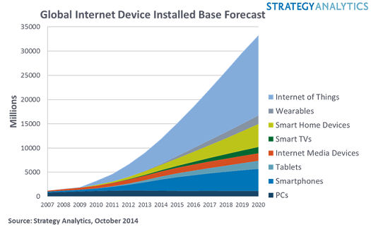

Slide 64
IoT security
There are two security issues with connected appliances. The one that these hackers focus on is the interference with the intended use of the device. The other is the exploitation of the device in brute force attacks. The hackers would have us focus on the former, at the expense of the latter. We will do that at our peril.

Slide 65
City transportation systems
Tags in vehicles, tags in fixed positions, tag readers,…
Can track location of vehicles, perform real-time traffic analysis, determine optimal routes,…
Use hybrid networks, combining Wi-Fi, GSM, GPS, IP, …
Used in bus systems, taxis,…

Slide 66
Possible layered architecture
Application layer: road guidance, shortest route,..
Intelligent service layer: vehicle management, data mining,..
Information awareness layer: associate and merge data
Resource management layer: collect real-time information from sensors, map matching,…
A Reference Architecture is needed

Slide 67
Issues
Large amounts of heterogeneous information: RFID, addresses, GPS data,…
Noisy data: must be cleaned
Need for unified data model
Data processing: probabilistic queries
Need for automatic event detection
New research needed
Efficient and flexible heterogeneous wireless networks are needed

Slide 68
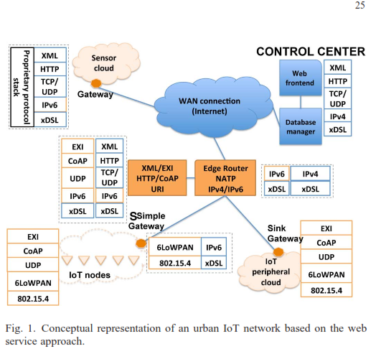

Slide 69
Computerized medicine
The Internet, wireless systems, and RFID sensors are opening a new era in medical care
Most activities in medical care can be integrated and performed remotely and pervasively
This change promises to improve medical care and reduce costs
However, we must consider security from the beginning and in all phases

Slide 70
Regulations
Medical information is very sensitive and must be protected. Most countries have severe restrcitions in the use of this information.
There are several regulations in the US about the handling of health information. The best known is the Health Insurance Portability and Accountability Act (HIPAA)
Title II of HIPAA, known as the Administrative Simplification (AS) provisions, requires the establishment of national standards for electronic health care transactions and national identifiers for providers, health insurance plans, and employers. The AS provisions also address the security and privacy of health data. The standards are meant to improve the efficiency and effectiveness of the nation's health care system by encouraging the widespread use of electronic data interchange
The HHS has promulgated five rules regarding AS: the Privacy Rule, the Transactions and Code Sets Rule, the Security Rule, the Unique Identifiers Rule, and the Enforcement Rule.

Slide 71
HIPAA
The Privacy Rule regulates the use and disclosure of certain information held by covered entities (healthcare providers, health care clearinghouses, employer sponsored health plans, and health insurers) and their business associates (lawyers, accountants, IT consultants). It establishes regulations for the use and disclosure of Protected Health Information (PHI).
The Transactions and Code Sets Rule defines specific transaction types. For example, the EDI Health Care Claim Transaction set (837) is used to submit health care claim billing information, encounter information, or both, except for retail pharmacy claims. It can be sent from providers of health care services to payers, either directly or via intermediary billers and claims clearinghouses.

Slide 72
The Security Rule
The Security Rule complements the Privacy Rule. While the Privacy Rule pertains to all Protected Health Information (PHI) including paper and electronic, the Security Rule deals specifically with Electronic Protected Health Information (EPHI). It lays out three types of security safeguards required for compliance: administrative, physical, and technical.

Slide 73
Privacy
Privacy is the right of individuals or groups to keep their personal information away from public knowledge or their ability to control personal information flow
In the electronic or the real world, people seek privacy, so they can perform their actions without others monitoring them
Individuals should be able to live without being disturbed and users interacting with the web, navigate without being identified. People providing information to medical institutions or storing their personal records in commercial companies should know what to expect about the privacy of their information.
This right is recognized by all civilized societies and is considered a fundamental human right. The first national privacy protection law was the Swedish Data act of 1973. This was followed by the US Privacy Act of 1974. The intent of this act was to protect individuals against invasion of privacy by the Federal Government. This law is complemented by the Computer Security Act of 1987, which defines requirements for federal agencies about the security of their information.

Slide 74
Medical care use cases

Slide 75
Abstract patient records
Patient Record
Describes the structure of patient information and the process of creating and maintaining them for a stay or treatment in a hospital

Slide 76
Basic patient record

Slide 77
Adding more information

Slide 78
Adding Role-Based Access Control

Slide 79
EHR standards
The Electronic Healthcare Record (EHR) is a lifetime record of an individual with the purpose of supporting continuity of care, and related education and research. It typically includes information about encounters (visits), lab tests, diagnostics, observations, medications, imaging reports, treatments, allergies,and therapies, as well as patient-identifying information and legal permissions.

Slide 80
EHR standards
The abstract record summarizes several standards: GEHR/openEHR, DICOM, HL7, IHE, and ISO TC 215
The abstract record is used to define the needed security
The needs come from the identified threats

Slide 81
Wireless medicine
Smart hospitals using RFID sensors
Assisted living
Wireless-controlled robots for medicine dispensing or distribution
Wireless IV pumps
Wireless access to medical records
Telemedicine
Guest networks for patients

Slide 82
Sensor-based hospital
A smart (sensor-based) hospital uses radio frequency (RFID) sensors to contribute to build a smart hospital by optimizing business processes, reducing errors and improving patient safety
Requires pervasive sensors and readers: doctors, patients, equipment, charts,…

Slide 83
Use cases
Perform patient identification. RFID bracelets may include patient id and some other useful information, e.g. blood type.
Blood tracking. RFID tags in bags can identify the patient for which they are intended.
Identify right patient and operation. In the operating theater, avoid confusion of patients, operations to be performed, and place of operations by correlating patient id with its EHR.
Prevent drug counterfeiting. Can use Electronic Product Codes (EPC) in drug packages. This increases patient safety.
Tracking equipment, patients, staff, and documents. All of these carry RFID tags and if we have readres in strategic places we can track all of them. A byproduct is the possibility of an accurate and efficient inventory system.
Avoiding theft of medical equipment. When something is stolen, we must add to the cost of the lost equipment the time to locate it and to reorder a nreplacement.

Slide 84
Assisted living requirements
1) Dependability: Critical services should be delivered in spite of the failures of useful but noncritical services
2) Low Cost and Flexibility: The assisted living infrastructure will be open with well defined interfaces, machine checkable QoS assumptions, and support the use of low-cost, third-party devices.
3) Security and Privacy: Medical and personal data will be protected with different levels of information disclosure to different roles (health care providers, medical team, relatives, and assisted persons).
4) Quality-of-Service Provisioning: Various forms of workload dynamics, e.g. monitoring information, audio commands, time-critical multimedia streams supporting tele-medicine. Quality of Service (QoS) will be provided at different levels depending on their criticality requirements.
5) Open standards—Any brand or type of device should be able to interoperate
6) Lighttweight, Easy-to-Use HCIs: The user interfaces will be easy-to-use, safe, accommodate with respect to user mistakes, and provide different control levels of information disclosure.
7) Flexible –combinations of hardware architectures, merging of features
8) Interoperable—Compatible with EHRs.

Slide 85
Devices
Health monitoring
Video monitoring
Pressure mats
Door alerts
Location badges
Movement detectors
Automatic lights
Medicine dispenser
Kitchen controls
Smart homes

Slide 86
Part of the class model

Slide 87
Activity diagram to remind of a task

Slide 88
Threats
Activity 1: Remind of activity/task
T11 Control site of patient site is an impostor
T12 Unauthorized reading of schedule
T13 Unauthorized writing of schedule
T14 Denial of service
….

Slide 89
Policies
T11: Mutual authentication
T12: Authorization/Access Control
T12: Authorization/Access Control
T12: Cell phone backup

Slide 90
WiFi threats
Attacker can set up its own AP
Intercept wireless printer traffic
OS attacks through the network
Denial of Service (RF signal jamming)

Slide 91
Summary
For existing systems, perform security auditing
System-critical and life-critical functions need backups
For new systems use a global-level design, starting from requirements. Define policies, analyze threats, select defense mechanisms
Each device should be integrated in a system-wide structure, where their device ids can be related to users
Notes:
91

Slide 92
Social networks
A social network is a structure of individuals or organizations, which are connected by one or more types of interdependency, such as friendship, affinity, common interests or knowledge. Social networks have existed for a long time in a looser way than now
The early Internet, now referred to as Web 1.0, significantly lowered the cost of accessing or publishing content to a global audience, as well as keeping in contact with friends and collaborators. Anyone with a web site could publish papers, post product information, or display whatever they wanted. Anyone with an Internet connection could follow links to access content. The content of websites was generally controlled by the individual, company or organization that created it.
Software tools were developed for contributing content and standards were developed for information and data exchange. E-mail and instant messaging tools made possible keeping in touch with existing contacts, and forum and chat-room spaces made possible to discover and temporarily interact with new people or groups. In that stage the Internet was mostly a repository of shared information with limited interaction

Slide 93
Web 2.0
Web 2.0 introduced some important changes, it allows anyone with a web connection to write as well as read
Anyone can have now its own web site and keep in contact with friends and collaborators in a simple and inexpensive way
Search engines, content-tagging by users, and user-generated content have made it much easier to interact. Content from different sites can be combined and used for any purpose.
However, in order to take advantage of these good things one now needs to join a structured social network
Many varieties of social networks have appeared, some just for keeping in contact with friends, but others for specialized uses
The idea is having a participatory group where everybody shares information and ideas with others in a shared space
Social network sites are structured as personal networks, with the individuals at the center of their own community. People and their online interactions are captured as published content on the web in a way that allows content and people-as-content to be traversed through social, rather than thematic links
New categories of communication such as broadcast, narrowcast, and private messaging have been created. Virtually everything is read/write with space for added metadata and comments.

Slide 94
Architectural aspects
Software development in this environment presents new challenges because of its richness and the need for security
The large amount of information about individuals creates a significant privacy problem
There is a variety of security threats to social networks and several serious incidents have already occurred
The state of security in social networks is rather primitive; they contain mostly information about individuals but there is little protection against privacy violations
Their platforms are also easy to penetrate by external attackers
We need to define what security requirements should be imposed on these organizations to protect their users.
We are building some patterns for this purpose

Slide 95
Threats to social networks
Usability of the security mechanisms is a fundamental design flaw. It doesn’t matter if the system has good security controls if they are too complex for the average users. Most privacy settings are confusing, cumbersome, and change frequently, so users lose track of their privacy restrictions. For example, Facebook’s Privacy Policy has almost 6000 words; its policies include 50 settings with over 170 options.
Many companies are encouraging their employees to use social networks as a way to reach potential clients or provide better service. That use may expose them to risks of illegal access to their corporate data or to their reputation. Often these companies don’t have any policies about the use of social networks by their employees.
The users themselves are a source of many security problems; many of them don’t know or don’t care about privacy. In surveys, e.g. the one mentioned in [21], many respondents were willing to let anyone see their full names, addresses, gender, and had few aspects that they wanted to hide (typically, religion or sexual preferences). In fact, some even bragged they did not have any secrets. What these people don’t realize is that information can be misinterpreted, propagated erroneously, and misused, e.g. for identity theft.
This position has started to reverse as many people are realizing that showing all this information is creating problems for them to get jobs.

Slide 96
More threats
In this moment the main source of privacy threats comes from the platform providers. Social networks are usually commercial enterprises that are trying to make money. They don’t charge their users and provide nice functions to entice them to join. However, the providers sell this information or the access to the users to external parties to generate profits. They encourage users to provide as much information as possible and to share it with as many people as possible. Sometimes they use deceptive policies that confuse users and make them provide more information, not to protect their information, and even to share it with external entities. Their privacy models allow internal applications to bypass the users’ privacy settings and can collect all their information. Facebook even allows third-party applications, which have not been checked for security, to run in its platform nd share users data with game companies and others.
Important sources of threats in any commercial system are insiders, the people who work at the companies that provide platforms or applications for the social networks.
Threats also come from members trying to access information with poor privacy controls.
Also, from external attackers who may take advantage of the platform weaknesses. Social engineering attacks, frequent in the Internet, become much faster and more effective using social networks, the attacker can reach much more people at one time. Spam can propagate farther and faster.
Not only privacy and security are at risk in poorly controlled social networks, reputation is another aspect that can suffer. People can post things about others, which can affect their lives. A company using the network can get a bad reputation if some users express the disapproval of their products or services. This kind of attack was very effective during the last US election.

Slide 97
And more threats
Other threats include the standard Internet threats: Malware: viruses, worms, Trojan horses, spyware, identity theft, phishing, account hijacking
Availability attacks can be very annoying to people used to keep track of their friends in real time. If you let others know always your location you are inviting burglars to your house. Web sites hosting social networks may keep your information indefinitely.
The effect of the platform and associated software is naturally very important, An example is ELGG, an open source platform. Elgg runs on a combination of the Apache web server, MySQL database system and the PHP interpreted scripting language. These are open source products but they are not particularly secure. The use of mashups can bring data leakage. Mobile access to social networks and their applications will bring new problems. Many social networks are using cloud-based platforms that may not have proper defenses.
Several incidents have shown the fragility of the current networks:
A recent breach in Facebook allowed users to see private information from other users.
Last December an attacker got into the master directory of Twitter’s addresses and tampered with its DNS to redirect users to the site of the “Iranian Cyber Army”.

Slide 98
Twitter hacked 09/10/11
A Twitter account belonging to NBC News was hacked on Friday evening by an entity that claimed, falsely, that an airplane had crashed at the site of ground zero in New York.
The account was swiftly taken offline and the news division apologized. The incident was deemed serious enough that the news anchor Brian Williams read the apology out loud on the “NBC Nightly News.”
The NBC Twitter account had about 130,000 followers, only a fraction of whom likely saw the Twitter message when it was posted. Still, the false claim rippled across the short messaging Web site in a matter of minutes, alarming some people on a day of heightened anxieties about potential terrorist attacks. Authorities have warned of a nonspecific bomb threat possibly tied to the 10th anniversary of the Sept. 11, 2001 terrorist attacks.

Slide 99
Facebook illegal data collection
In June, the court said that Facebook indiscriminately tracks internet users - even non-Facebook users - when they visit its pages or pages on other sites with "like" or "share" buttons.
Since then, the BPC's lawyers have called Facebook "as bad as the NSA [National Security Agency]."
This 48 hours or-else decision is only the latest EU action against private data flowing into Facebook.
Last month, the EU's highest court struck down the transatlantic Safe Harbor agreement, which had allowed companies to transfer European citizens' personal data to the US, calling the agreement "invalid" because it didn't protect data from US surveillance.
At the heart of the recent Belgian court case is a move Facebook made in June 2014 to give advertisers more ammunition to target users, by mixing data about what we do on its site with data about what we do on other sites.

Slide 100
Facebook data II
The Belgian court on Monday said that Facebook does indeed use a special cookie that visitors pick up if they visit a friend's page on Facebook or any other page on the web with Facebook like or share code in it - all without the visitor having ever signed up for a Facebook account.
That cookie stays on a given device for up to two years, enabling Facebook to keep track of people and what they've looked at on the web.
Meanwhile, back on its home turf, Facebook is having a much easier time of it with a US regulator - the Federal Communications Commission (FCC) - having recently shrugged off the notion that it should trouble Google or Facebook with demands to honor "Do not track" requests.
The FCC dismissed a petition from rights group Consumer Watchdog, which had called on the commission to require "edge providers" - a catch-all term covering websites and apps, including Google, Facebook, YouTube, Pandora, Netflix, and LinkedIn - to honor such requests from consumers.
The FCC's rationale: it doesn't have the authority.
Consumer Watchdog thinks otherwise, and it's reportedly considering an appeal.

Slide 101
Participation-collaboration pattern
Intent
Describe the functionality of the collaboration between users participating in social networks, together with access and rights restrictions.
Example
A small company wants to create a manual covering the use of one of its products. The traditional approach is to gather a small set of experts to write it, hopefully reducing the potential for costly errors. However, manuals face a market of readers with different skill levels, and the company’s writers may not always get everything right. Customers often know what they need better than the company does, but the flow of information has traditionally gone from the publisher to the customer, rather than the other way around. It is hard then to produce good-quality manuals
Context
This pattern can be useful when a group of people has a common interest in sharing and communicating information about a specific subject. They all have access to the facilities of an environment such as the one provided by Web 2.0.

Slide 102
Problem
There are tasks where we need the collaboration of a large variety of people, who can provide unique points of view or expertise. How do we share information among people in different places and with different areas of expertise so they can work together?
The solution for this problem is affected by the following forces:
There are issues that can be solved better when many people collaborate, we should provide a convenient way for them to interact.
Consistent participation may provide a platform for some users to be recognized as experts. We want to know who are the users who have a high level of expertise in some area.
A person needs to be designated to accept or reject the changes in the content made by the users; otherwise the collaboration may be overwhelmed by some users or become corrupted with spurious content.
We should control who can propose new content to avoid spammers and similar input providers.

Slide 103
Participation Collaboration class diagram

Slide 104
Use cases

Slide 105
More secure social network patterns
Secure Location-Based pattern
Provide a person with the location of those friends who have allowed their locations to be shown and restrict the location information only to this group. The people in the group may also temporarily block their locations.
Collaborative Tagging pattern
Make content more meaningful and useful by using keywords to tag bookmarks, photographs, and other content.

Slide 106
Voter Registration Rolls in 2 States Are Called Vulnerable to Hackers http://www.nytimes.com/2012/10/13/us/politics/cracks-in-maryland-and-washington-voter-databases.html?_r=0
Computer security experts have identified vulnerabilities in the voter registration databases in two states, raising concerns about the ability of hackers and others to disenfranchise voters.
In the last five years, Maryland and Washington State have set up voter registration systems that make it easy for people to register to vote and update their address information online. The problem is that in both states, all the information required from voters to log in to the system is publicly available.
It took The New York Times less than three minutes to track down the information online needed to update the registrations of several prominent executives in Washington State. Complete voter lists, which include a name, birth date, addresses and party affiliation, can be easily bought — and are, right now, in the hands of thousands of campaign volunteers.

Slide 107
Voter registration II
Computer security experts and voting rights activists argue that a hacker could use that information to, say, change a person’s address online to ensure that the voter never receives a ballot in Washington, where voting is now done entirely by mail. In Maryland, hackers could ensure that a voter is not listed on the precinct register at a designated polling station. In that case, the voter would be redirected to another precinct, or asked to fill out a provisional ballot. In both cases, the person would not be able to vote in local, or possibly, Congressional races.
But the real concern, critics say, is that large numbers of voters from one political party, or demographic, could have their information changed by automated computer programs. A program that could change tens of thousands of voter records at once, they say, would require only a dozen lines of code.

Slide 108
Voting Security Bill Introduced in US House (November 7, 2017)
A bill introduced in the US House of Representatives would require that states use voting systems that have paper backups and that close elections would be subject to audits. The Safeguarding Election Infrastructure Act bears similarities to the Securing America's Voting Equipment Act, which was recently introduced in the Senate. Both bills aim to improve cyber security information sharing between the federal government and state election officials, and both ask that the Department of Homeland Security (DHS) streamline security clearances for state election officials so that they can receive classified information.
Read more in:
- thehill.com: the bill would require paper voting, recounts in close elections

Slide 109
References
A. Banerjee, K.K. Venkatasubramanian,T. Mukherjee, and S.K.S. Gupta, “Ensuring safety, security, and sustainability of mission-critical cyber-physical systems”, Procs. of the IEEE, vol. 100, No 1, January 2012, 283-299.
E.B.Fernandez and M.M. Larrondo-Petrie, "Designing secure SCADA systems using security patterns", Procs. of the 43rd Hawaii Conf. on Systems Science, Honolulu, HI, Jan.2010, 1-8. http://ieeexplore.ieee.org/stamp/stamp.jsp?tp=&arnumber=5428672
E.B.Fernandez, Jose Ballesteros, Ana C. Desouza-Doucet, and M.M. Larrondo-Petrie, “Security Patterns for Physical Access Control Systems”, in S. Barker and G.J. Ahn (Eds.), Data and Applications Security XXI, LNCS 4602, 259-274, Springer 2007. Procs. of the 21st Annual IFIP WG 11.3 Working Conference on Data and Applications Security, Redondo Beach, California, U.S.A, July 8-11, 2007
Carolina Marin, E.B.Fernandez, and M.M. Larrondo-Petrie, "Patterns for social networks in Web 2.0", Procs. of the 8th Latin American and Caribbean Conf. for Eng. and Technology (LACCEI'2010), June 1-4, 2010, Arequipa, Peru
Mihaela Cardei, E. B.Fernandez, Anupama Sahu, and Ionut Cardei, "A pattern for Wireless System Architectures", Procs. of Asian PLoP 2011, Tokyo, Japan.

